Slide 1

Natural Language Processing NLP in one day

Slide 2

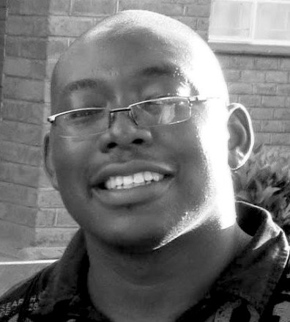
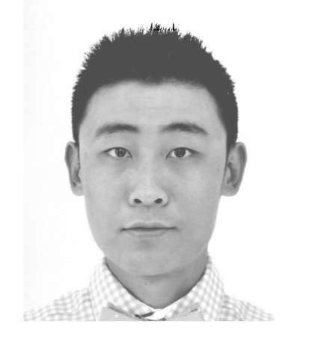
Introduction
Angus Roberts
Senior Lecturer,
Health Informatics
Yamiko Msosa
Research Fellow,
Health Informatics
Leo Xinyue Zhang
PhD Student,
Clinical NLP

Slide 3
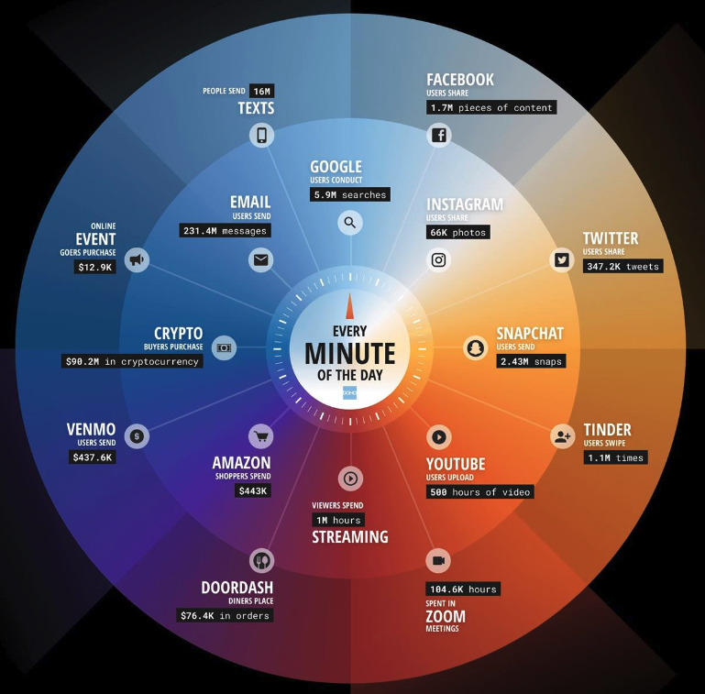
Text is everywhere
Data Never Sleeps 10.0 from domo.com (April 2022)

Slide 4
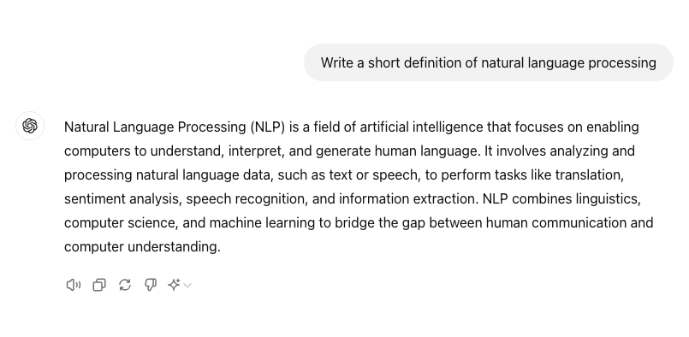

Generative AI

Slide 5
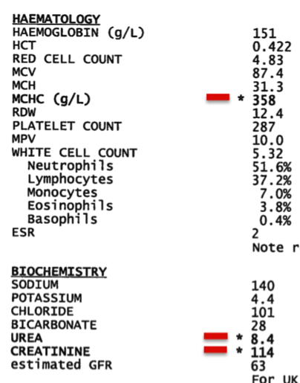
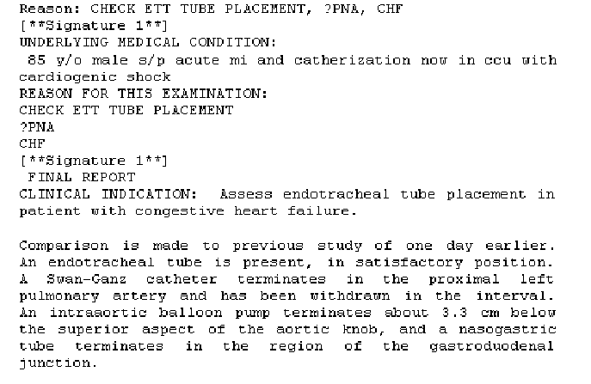
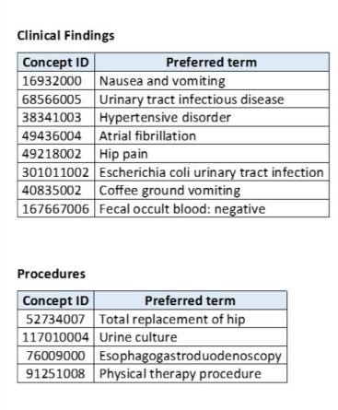
Electronic health records (EHRs) – structured and unstructured information

Slide 6
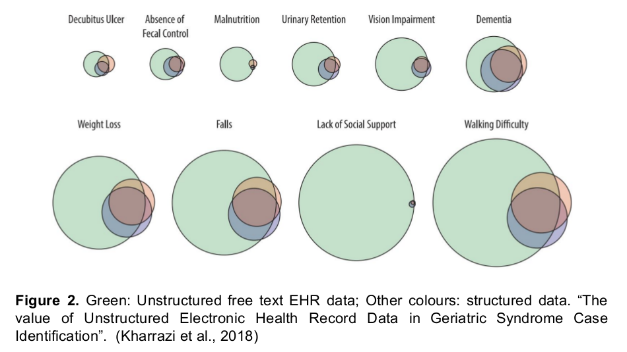
How much unstructured, textual information is in an EHR?

Slide 7
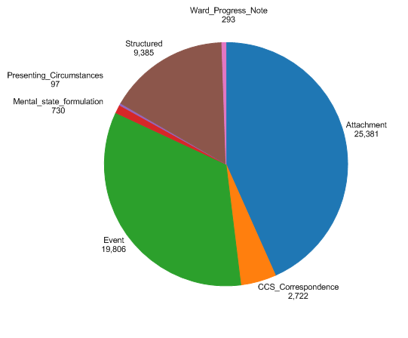
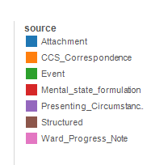
An example – Mini Mental State Examinations

Slide 8
This course
Pre-workshop - video lectures and study material
You did do all of it, didn’t you?

Slide 9
This course
Pre-workshop - video lectures and study material
You did do all of it, didn’t you?
Workshop – practicals
And a few linking presentations

Slide 10
This course
Pre-workshop - video lectures and study material
You did do all of it, didn’t you?
Workshop – practicals
And a few linking presentations
Post-workshop – self-study reading material

Slide 11
This course
Pre-workshop - video lectures and study material
You did do all of it, didn’t you?
Theory, methods
Workshop – practicals
And a few linking presentations
Post-workshop – self-study reading material

Slide 12
This course
Practical
techniques
Pre-workshop - video lectures and study material
You did do all of it, didn’t you?
Theory, methods
Workshop – practicals
And a few linking presentations
Post-workshop – self-study reading material

Slide 13
Can you learn NLP in a day
No
Watch the pre-course material
Go through the reading material
Find other sources of information
Find a collaborator!

Slide 14
Course material
All course material can be found on GitHub
Let’s take a look:
https://github.com/KCL-Health-NLP/nlp-one-day-workshop/tree/main

Slide 15
Thank you
angus.roberts@kcl.ac.uk https://www.kcl.ac.uk/people/angus-roberts

